Slide 1


地球低軌道環境観測衛星「てんこう」，および「てんこう２」
Microsatellite utilization symposium
January 18th, 2022
日本大学 理工学部 航空宇宙工学科
奥山 圭一

Slide 2
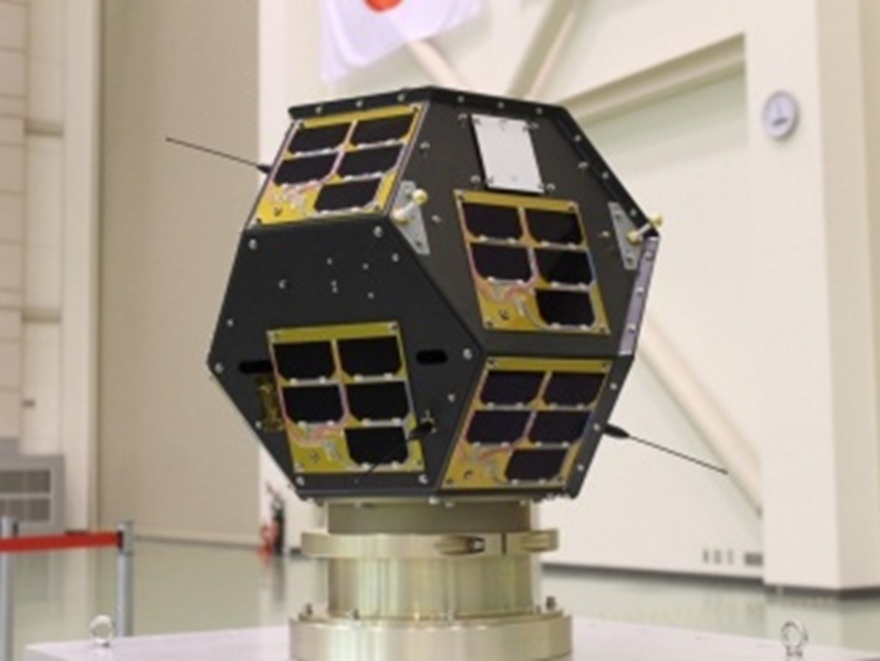
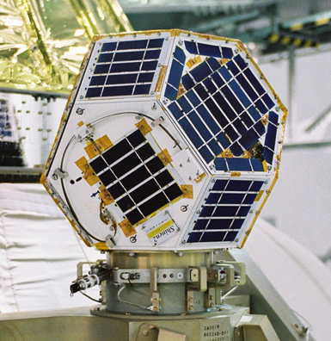
“Shin-en 2” and “Ten-Koh”
Deep Space Communication Experiment Probe “Shin-en 2”
Low Earth Orbit Environment Observation Satellite "Ten-Koh”
In order to complete the development in about 15 months, Shin-en 2 heritage was applied.

Slide 3
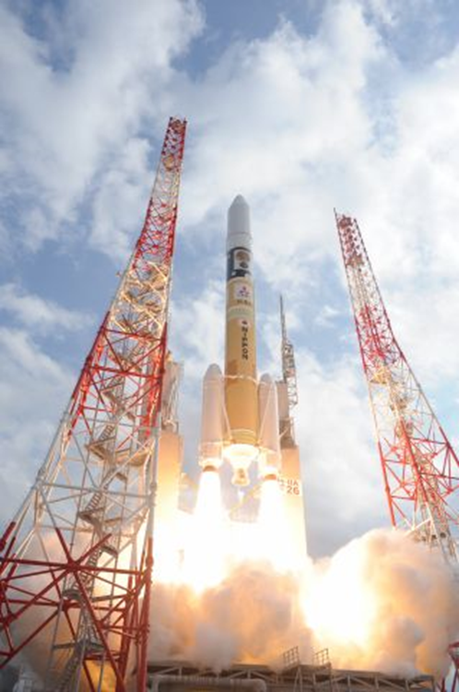
Launching: December 3rd, 2014
Size: 470 x 495 x 495 mm
Weight: 17.8 Kg
A Piggyback Probe for The JAXA’s Asteroid Explorer “Hayabusa 2”

Slide 4
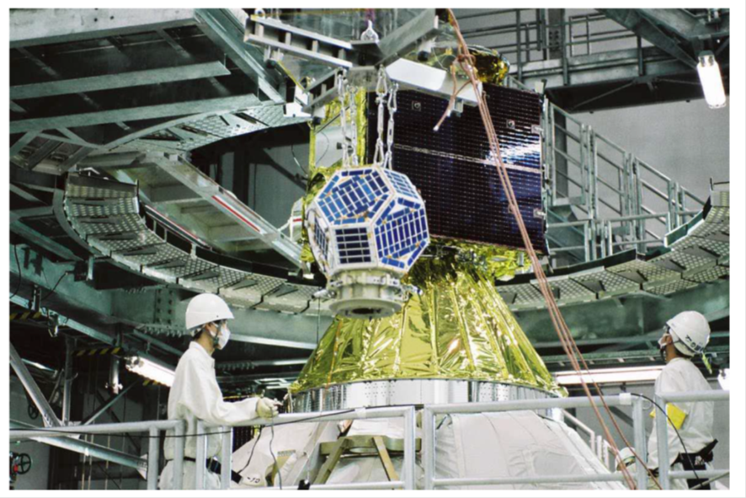
“Hayabusa 2” and “Shin-en 2”

Slide 5
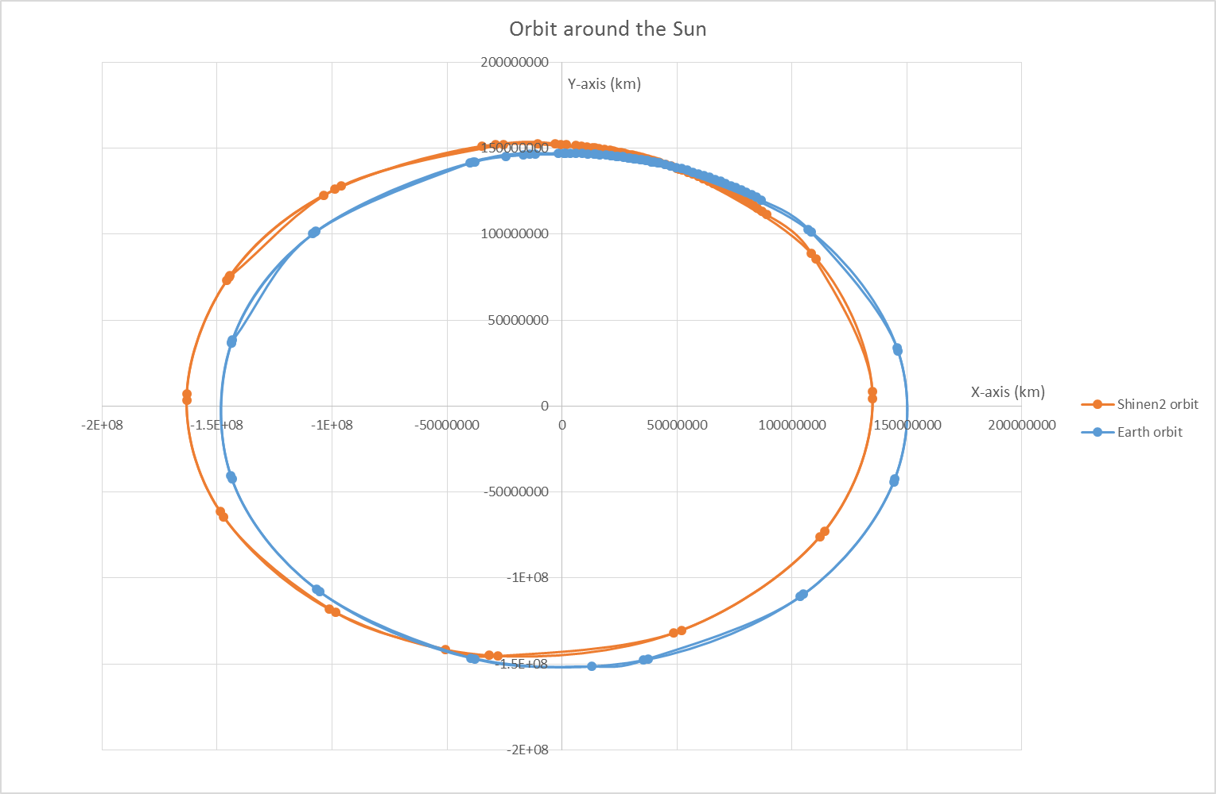
Orbits of the Earth and “Shin-en 2”

Slide 6
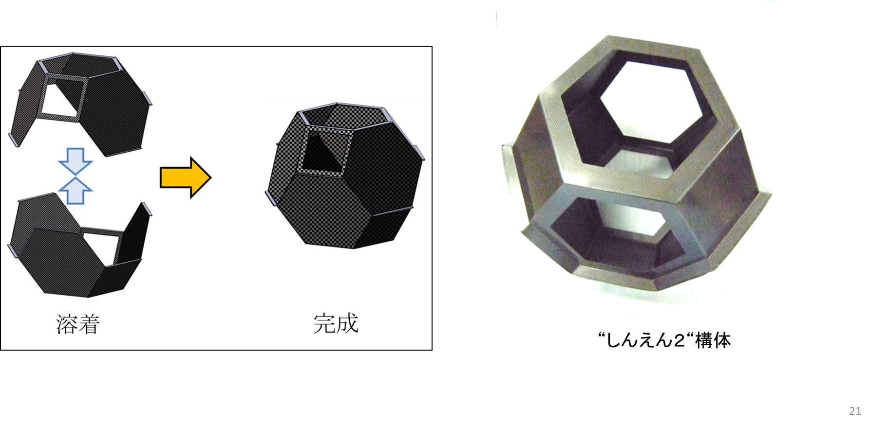
External structure of "Shin-en 2"
Structure made of carbon fiber reinforced thermoplastic resin composite material “CFRTP”

Slide 7
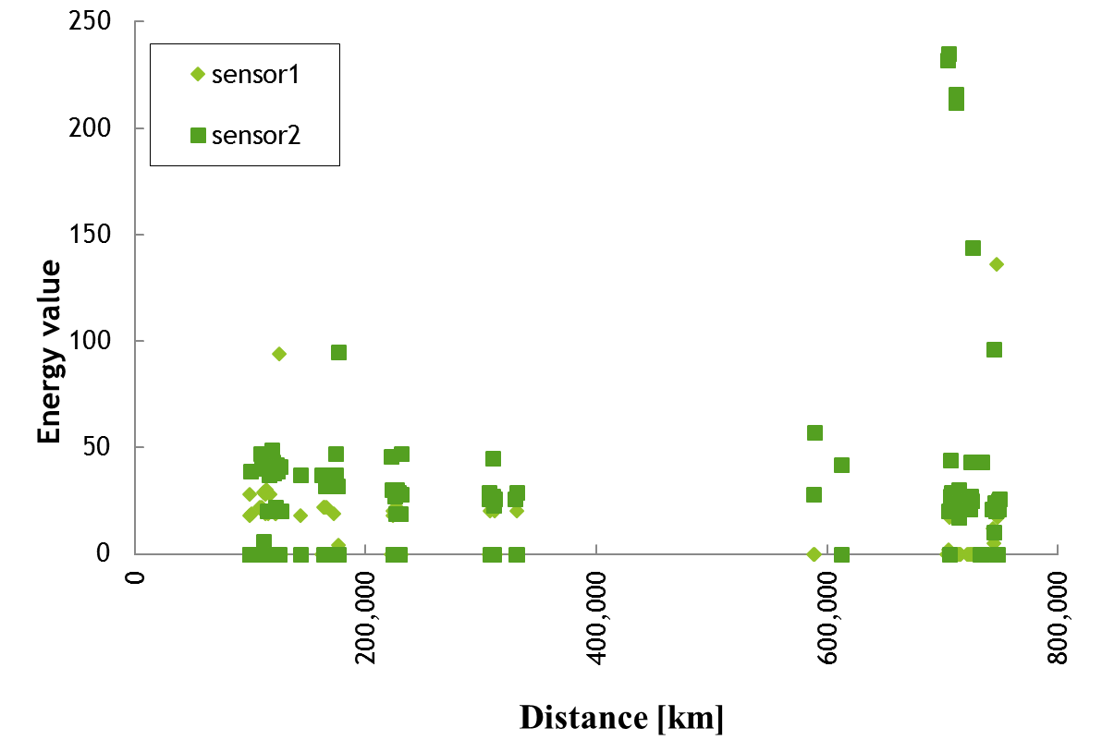
Data reception result from “Shin-en 2”

Slide 8
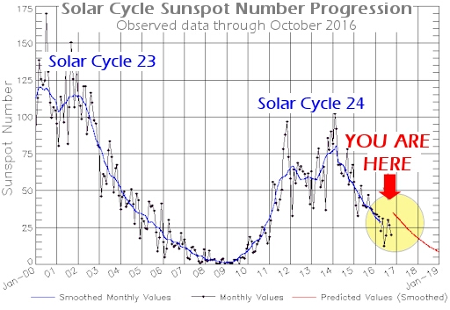
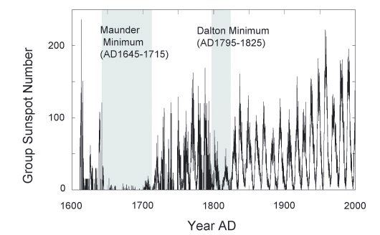
出典： http://cosmology.com/ClimateChange104.html
出典： http://spaceweather.com/

Slide 9
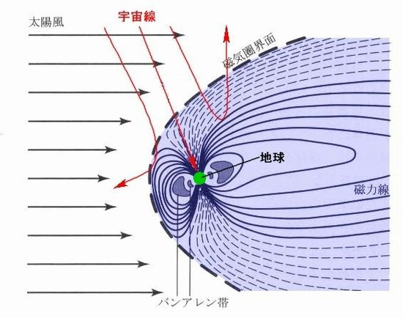
出典： http://www.env01.net/fromadmin/contents/2015/2015_09.html
出典：太陽風と地球磁場（別冊サイエンス）

Slide 10
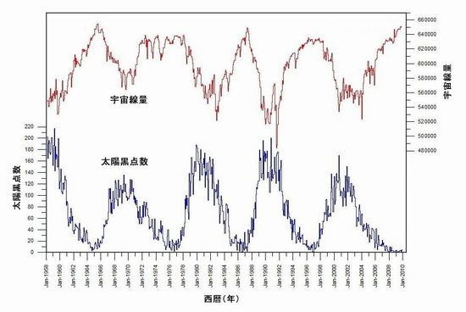
出典： http://www.env01.net/fromadmin/contents/2015/2015_09.html

Slide 11
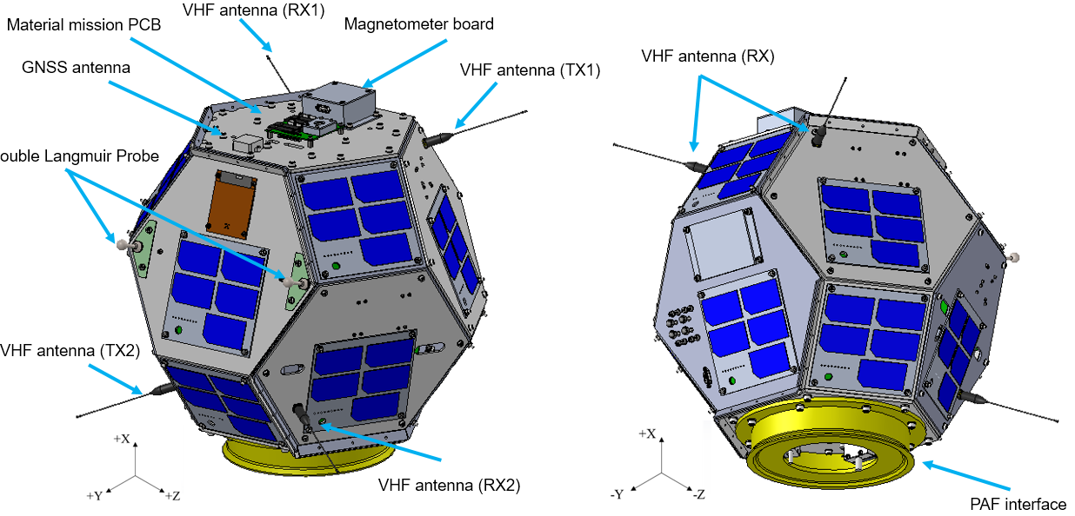
Low Earth Orbit Environment Observation Satellite "Ten-Koh”
CFRTP degradation observation device
Carbon fiber reinforced thermosetting resin composite (CFRP)

Slide 12

Low Earth Orbit Environment Observation Satellite "Ten-Koh”
CFRTP degradation observation device
Magnetometer
Ultra low power deep space
communication antenna
Double Langmuir probe

Slide 13
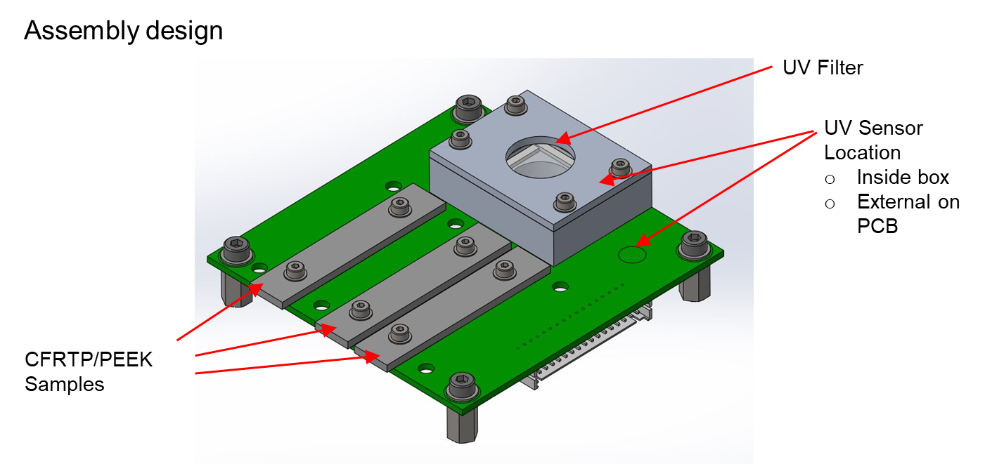
Low Earth Orbit Environment Observation Satellite "Ten-Koh”
CFRTP degradition observation device

Slide 14
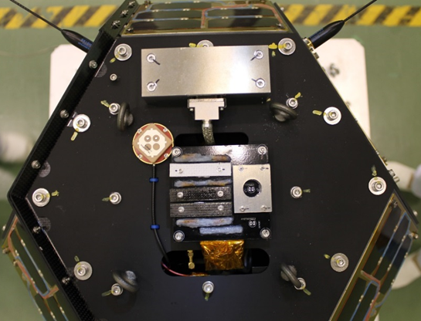
Low Earth Orbit Environment Observation Satellite "Ten-Koh”

Slide 15
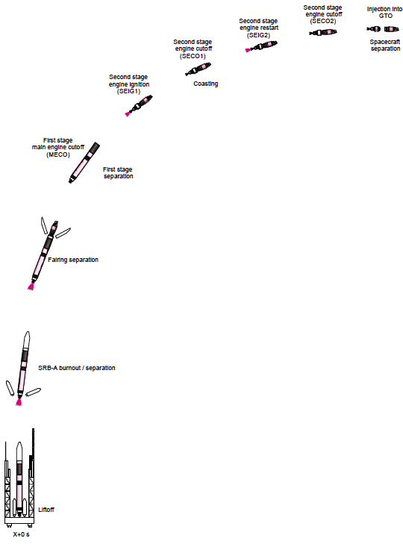
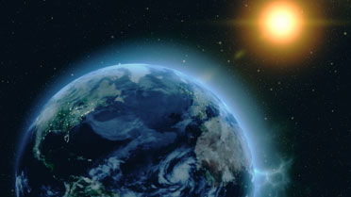
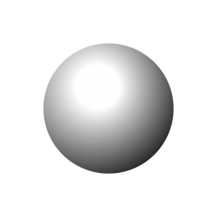
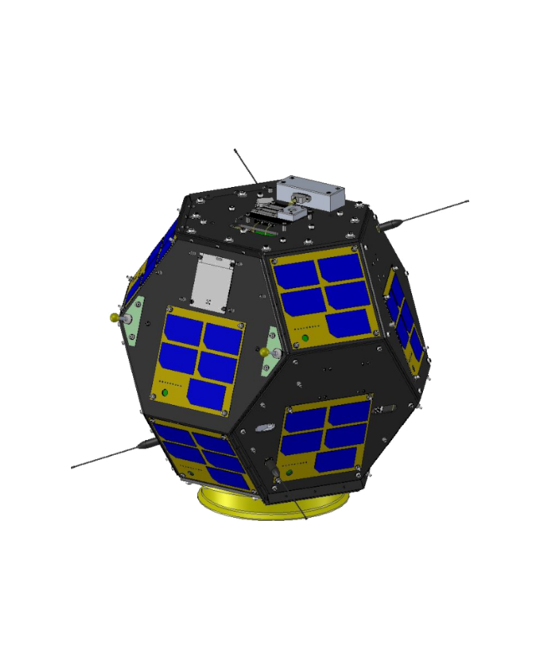
Low Earth Orbit Environment Observation Satellite "Ten-Koh”
Testing for survivability
Space environment testing
Galactic Cosmic Rays
Trapped electron & proton flux
SEP
UV & X-Ray
Charge & discharge
Magnetic field
lines
Launch environment testing
Rocket environment (launching)
Separation from main vehicle
Outgassing
Atomic oxygen
Emerging technologies have bigger susceptibility of failure due to space environment
Debris, meteoroid
Thermal cycling
20 – 25% of anomalies caused by the space environment (Koga 2016)

Slide 16
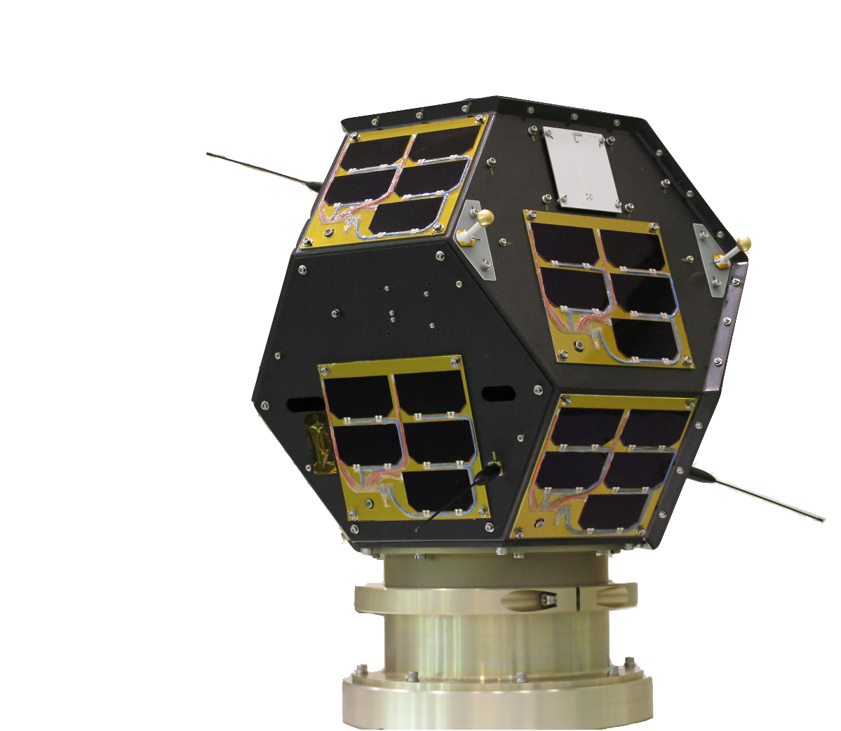
Low Earth Orbit Environment Observation Satellite "Ten-Koh”
Mass: 23.3 kg
Shape: Quasi-sphere ~50cm (CFRP)
Orbit: Sun-synchronous, 610 km, 97.8 deg
Launch date: 29 Oct 2018 (Tanegashima, Japan)
Launch vehicle: H-2A (as a piggyback payload)
Development time: 16 months
LATS: Lightweight Ablator series for Transfer vehicle
CFRP: Carbon Fiber Reinforced Polymer
Main missions:
Investigate the change of physical properties of LATS and CFRP materials exposed to the space environment.
To detect MeV-range electrons in LEO and investigate the space radiation environment in the presence of a low solar activity.
To characterize the plasma environment around a spinning spacecraft.

Slide 17
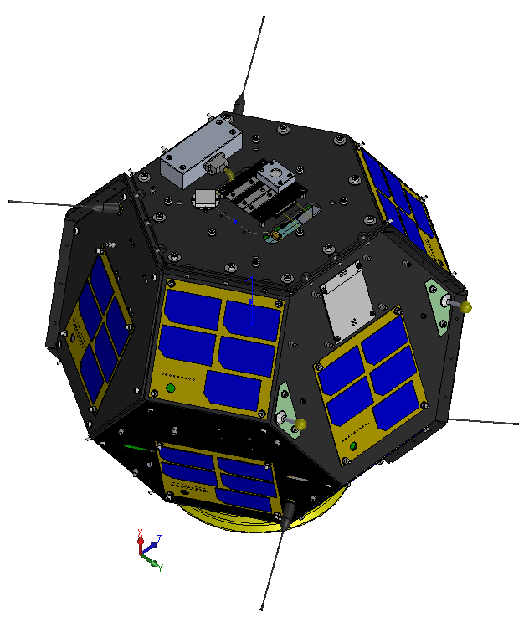
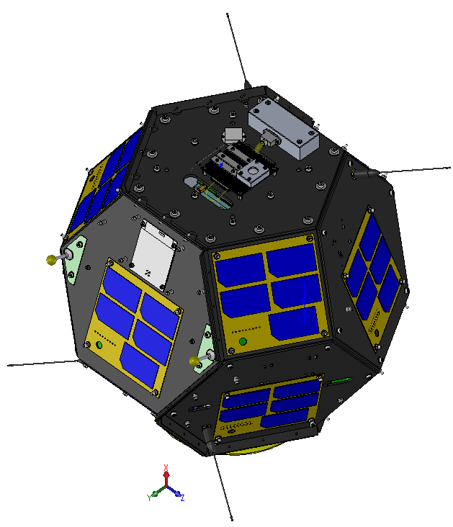
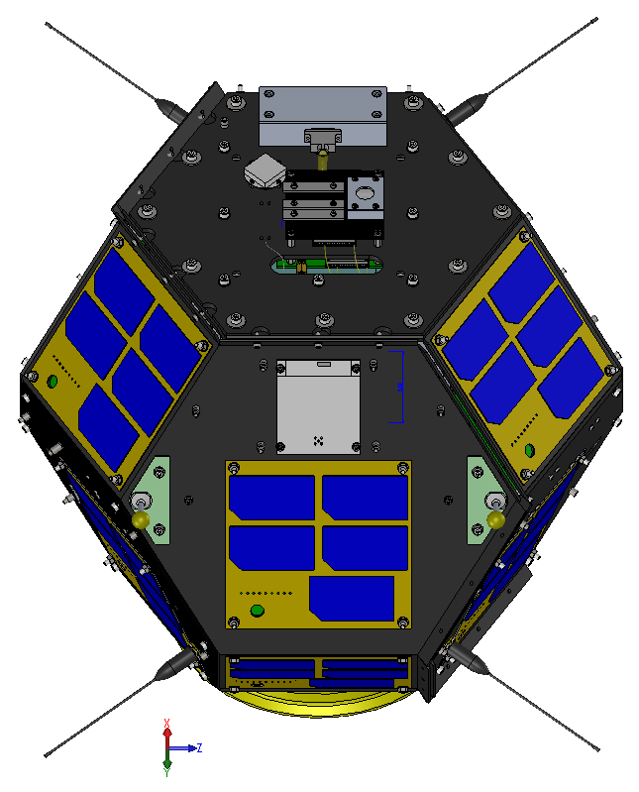
Ten-Koh satellite
Magnetometer
GNSS antenna
Magnetometer
Material Mission (material samples board)
Monopole antennas
GNSS antenna
Material Mission (material samples board)
Solar panels
DLP probes (electrodes)
Monopole antennas
Monopole antennas
AS

Slide 18
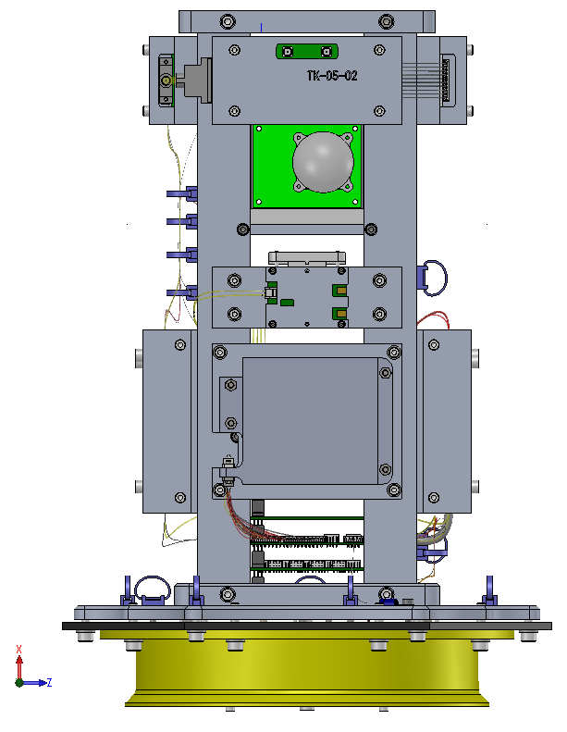
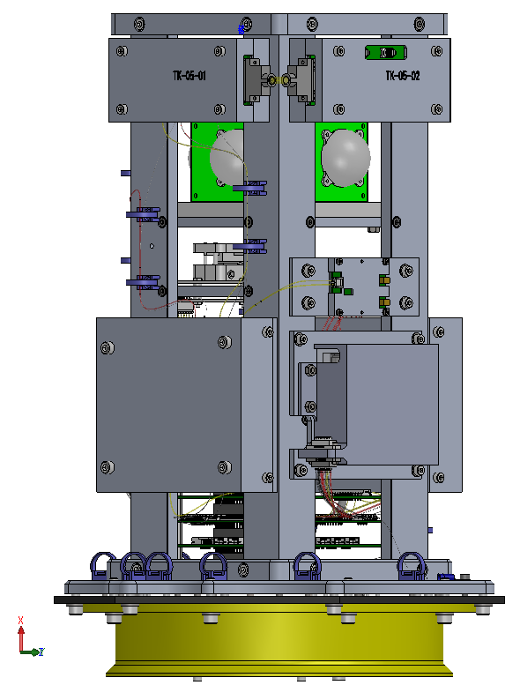
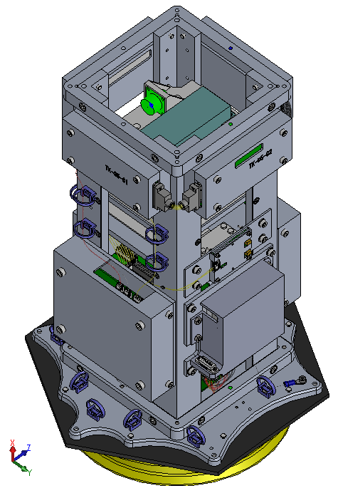
Low Earth Orbit Environment Observation Satellite "Ten-Koh”
Ten-Koh satellite
DLP measurement electronics
DLP isolated power & GND
ECU (Experiment Control Unit)
DLP measurement electronics
CPD
(Liulin detector)
WJST TxRx
CPD
(CMOS detectors)
RDS_PL
RDS_PL
RDS_PL
RDS_BUS
Battery 1

Slide 19
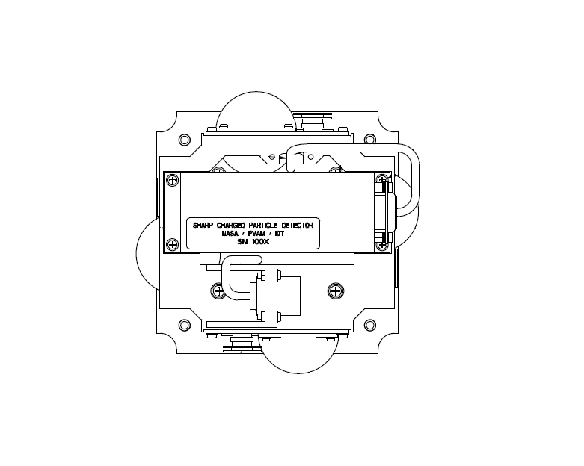
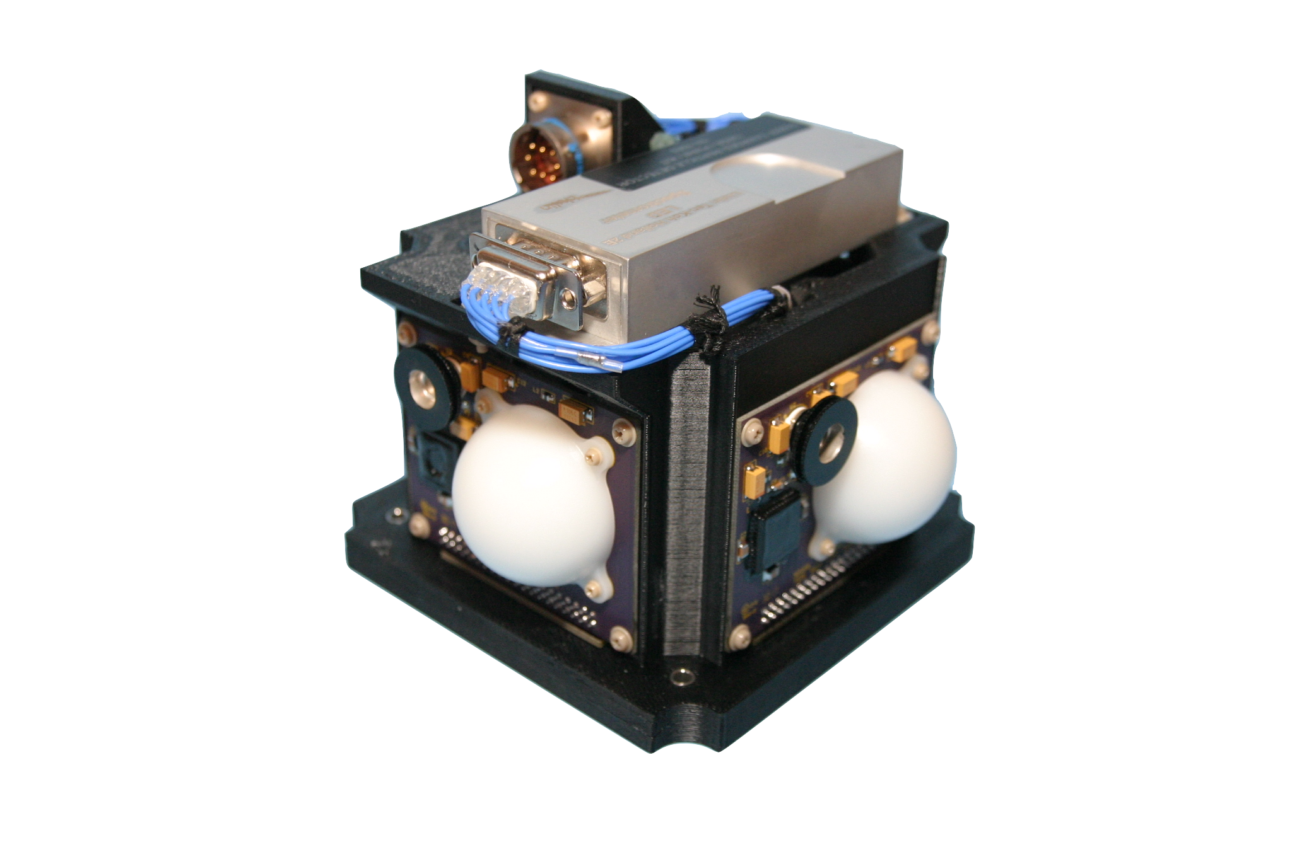
Low Earth Orbit Environment Observation Satellite "Ten-Koh”
Sensor Functionality
CMOS-0: X-Ray
CMOS-1: Polyethylene Sphere (shielding experiment)
CMOS-2: Open for ambient radiation measurements
CMOS-3: Polyethylene Sphere (shielding experiment)
CMOS-4: Open for ambient radiation measurements
CMOS-5: Polystyrene Sphere (tissue equivalent)
CMOS-6: X-Ray
CMOS-7: Polystyrene Sphere (tissue equivalent)
Liulin: Dosimeter (spectrometer)
Ten-Koh CPD payload
CPD CMOS & Liulin detectors distribution
SIDE B
CMOS-3
CMOS-2
CMOS-4
Liulin spectrometer
CMOS-1
SIDE C
SIDE A
CMOS-5
CMOS-0
X-rays detectors range:
47kV to 680 kV
CMOS-6
Power and data interface
CMOS-7
SIDE D

Slide 20
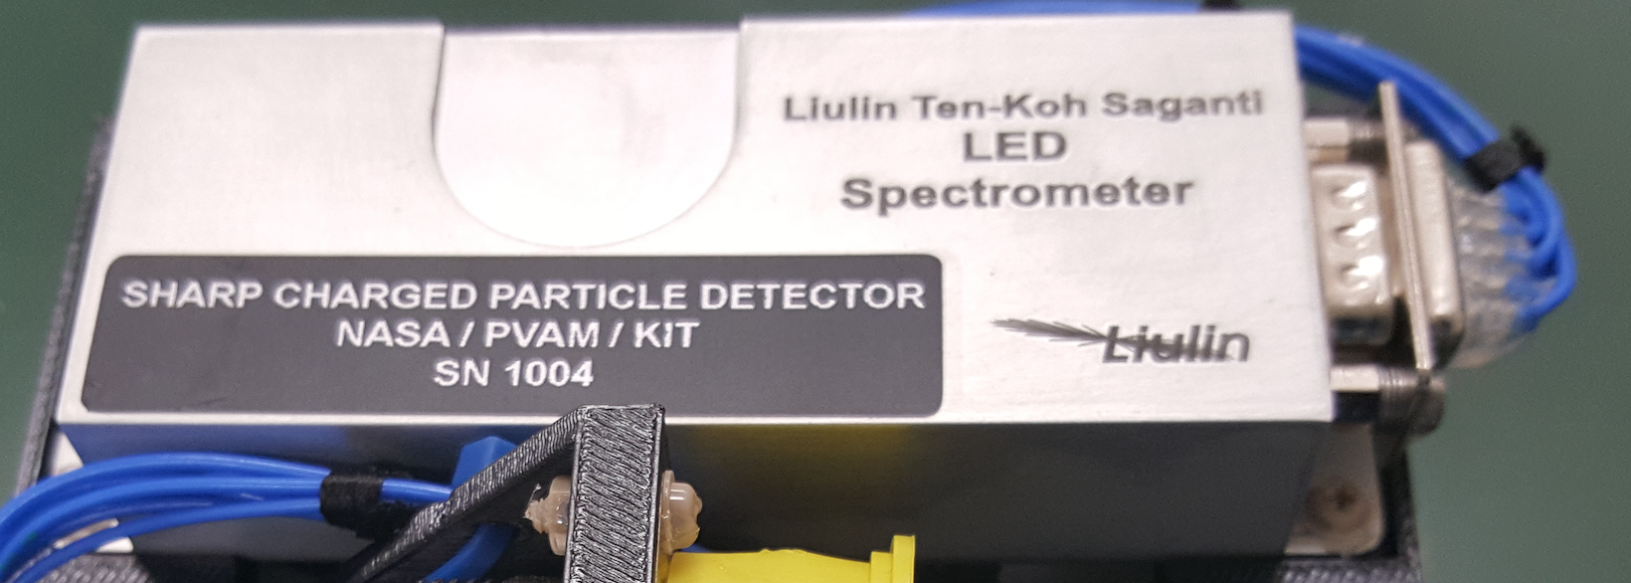
Low Earth Orbit Environment Observation Satellite "Ten-Koh”
In-orbit testing strategy: Liulin detector
Si detector (2 x 1 cm)
Parameter | Min | Max
Dose rate [Gy/h] | 1.12x10⁻⁸ | 0.188
Flux [particles/cm2/s] | 0.01 | 10000
Deposited energy range [MeV] | 0.081 | 20.833
Energy resolution [MeV/ch] | 0.0814
Total number of channels | 256

Slide 21
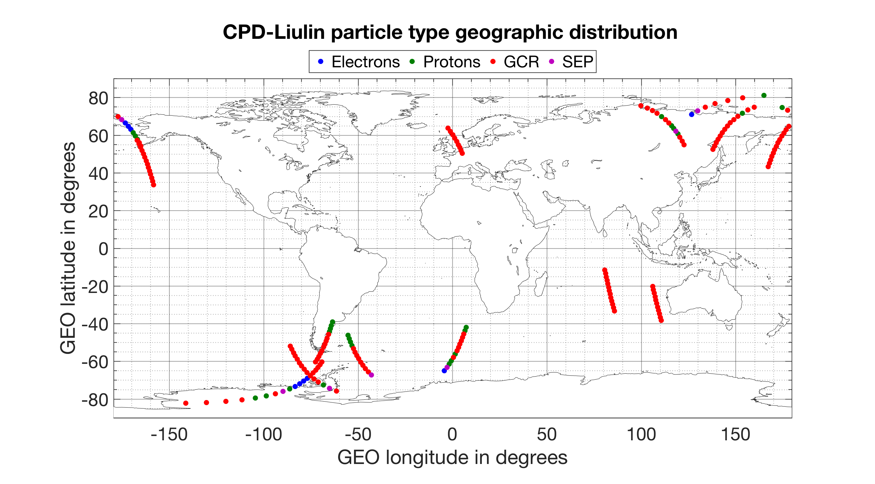
Low Earth Orbit Environment Observation Satellite "Ten-Koh”
Particle identification based on the dose-to-flux ratio (D/F)

Slide 22
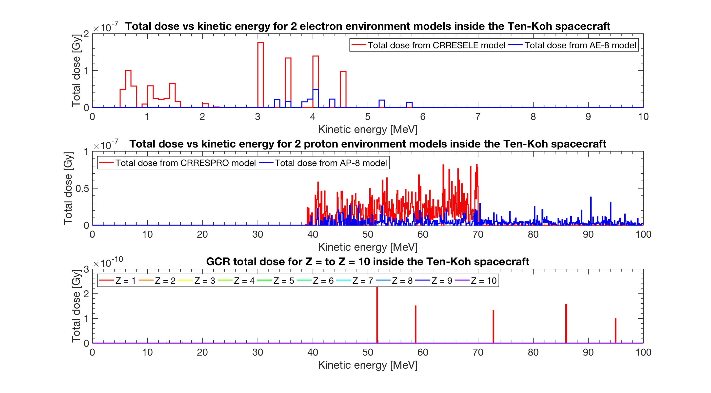
Low Earth Orbit Environment Observation Satellite "Ten-Koh”
Predicting TID
DOSE
AE-8: 1.8246×10⁻⁷ Gy
CRRESELE: 9.84279×10⁻⁷ Gy
AP-8: 2.4338×10⁻⁶ Gy
CRRESPRO: 6.6071×10⁻⁶ Gy
CREME96: 7.68696×10⁻¹⁰ Gy
(Z1 to Z10)
TID_{AE-8,AP-8,CREME96} = 2.617×10⁻⁶ Gy
TID_{CRRESELE,CRRESPRO,CREME96} = 7.592×10⁻⁶ Gy

Slide 23
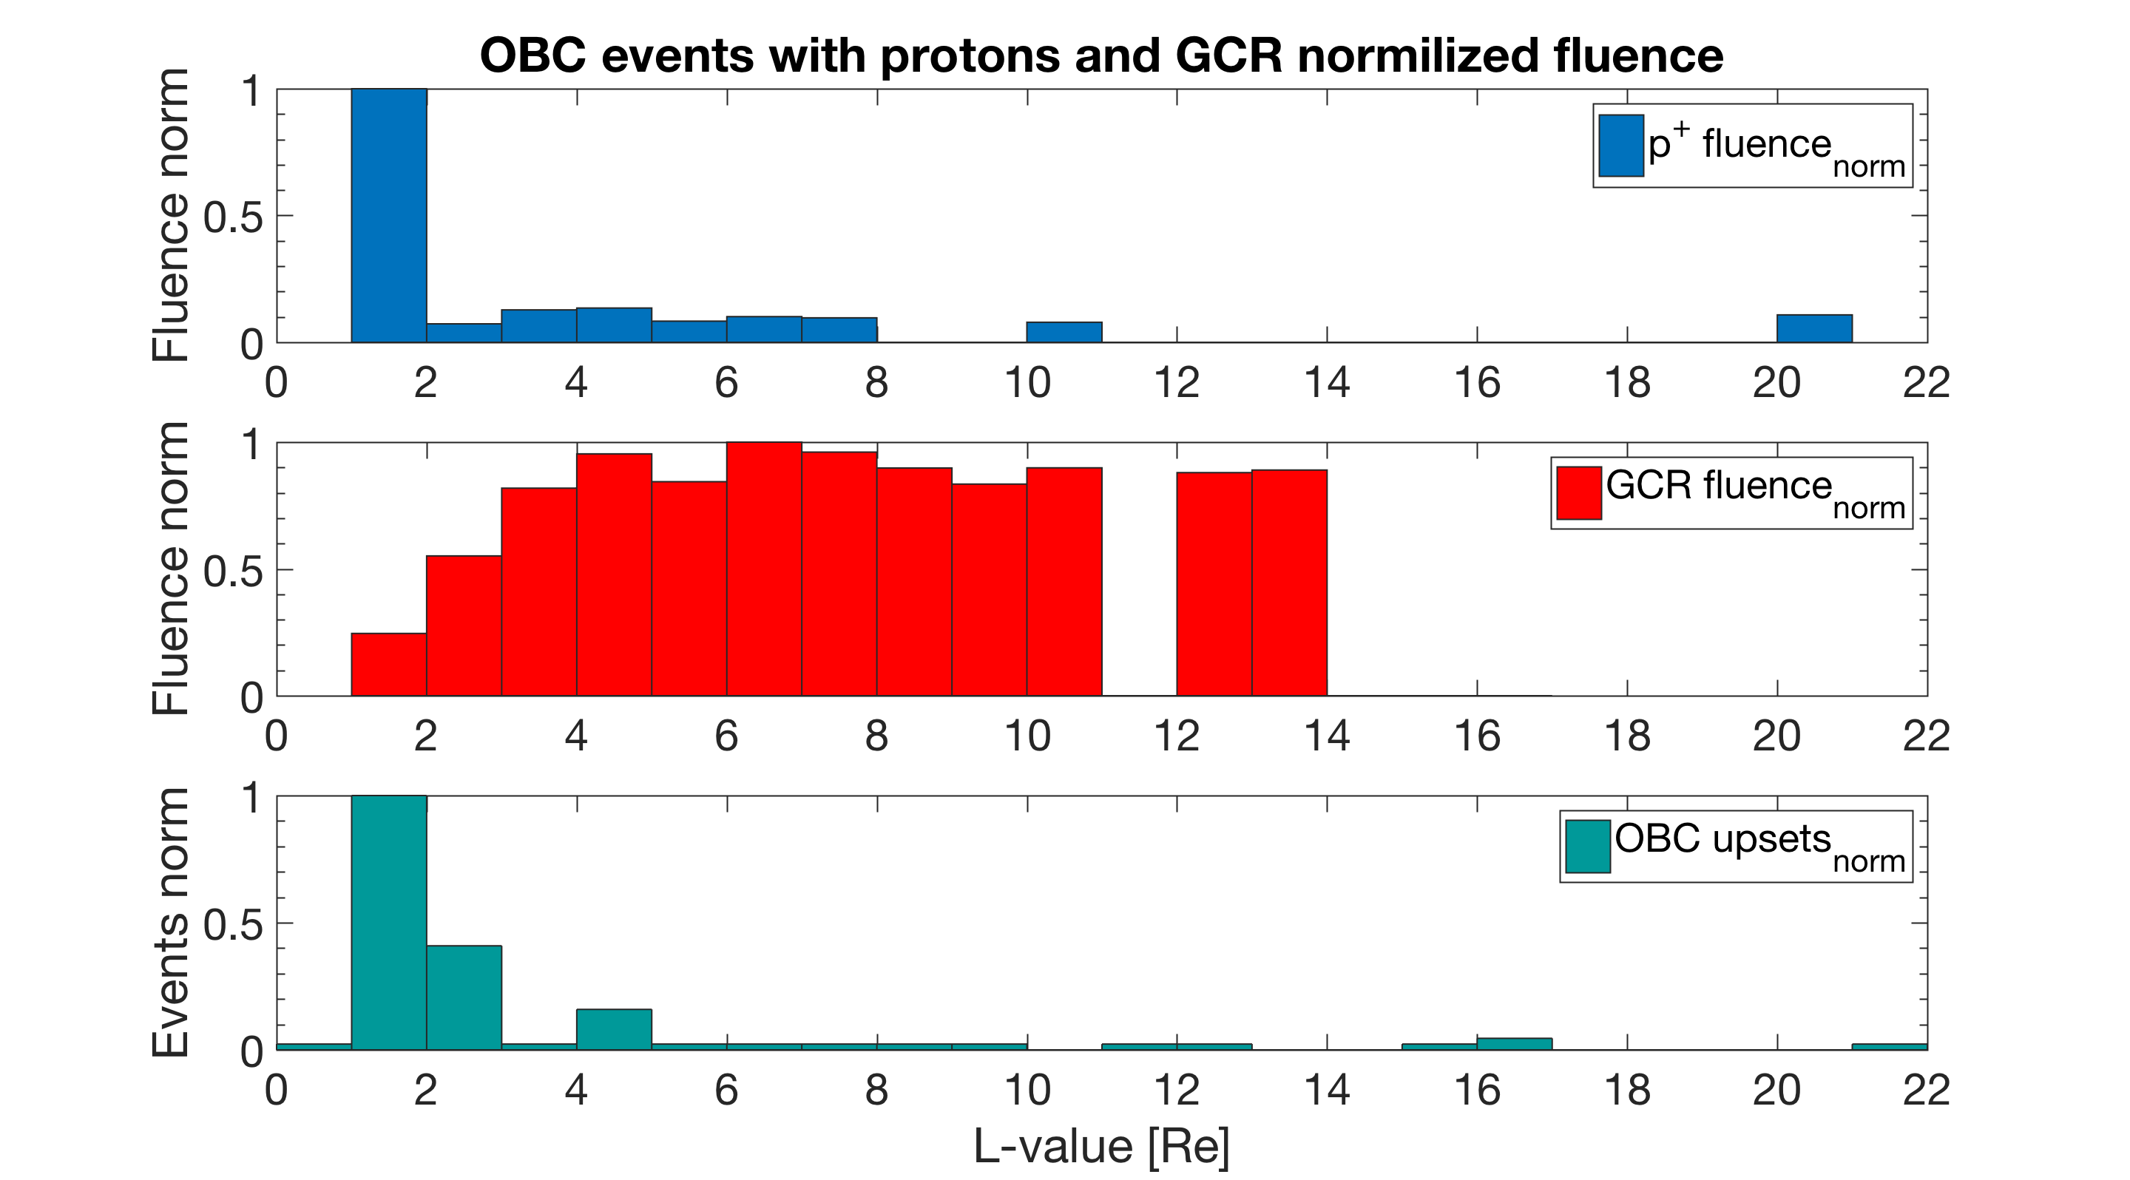
Low Earth Orbit Environment Observation Satellite "Ten-Koh”
SEU events source
Correlation coefficient
r_{protons} = 0.9184
r_{GCR} = -0.2205

Slide 24
Low Earth Orbit Environment Observation Satellite "Ten-Koh”
24

Slide 25
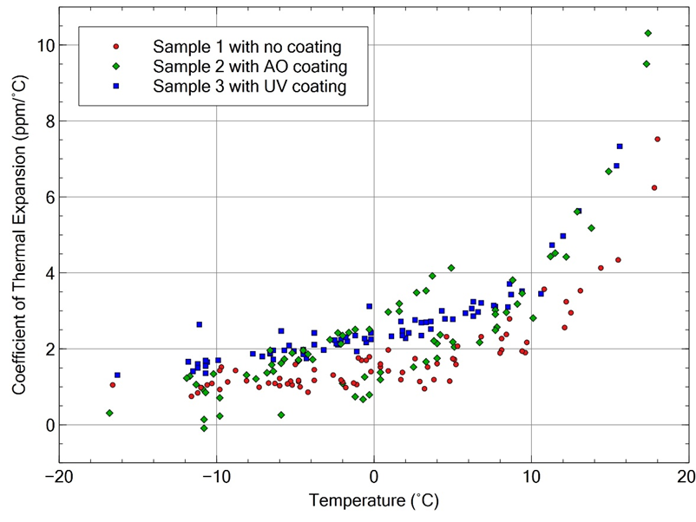
Low Earth Orbit Environment Observation Satellite "Ten-Koh”
25
25

Slide 26
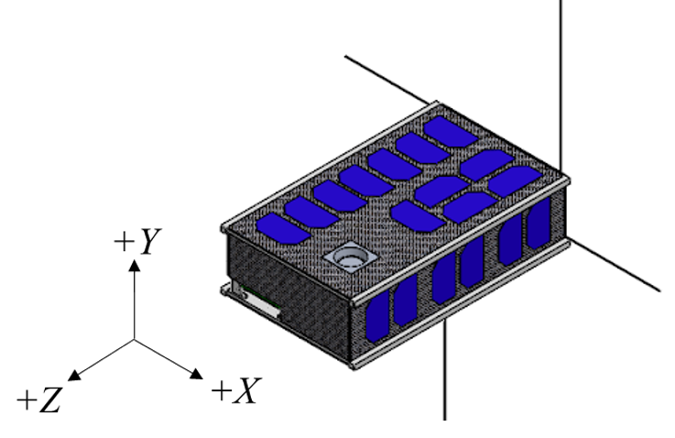
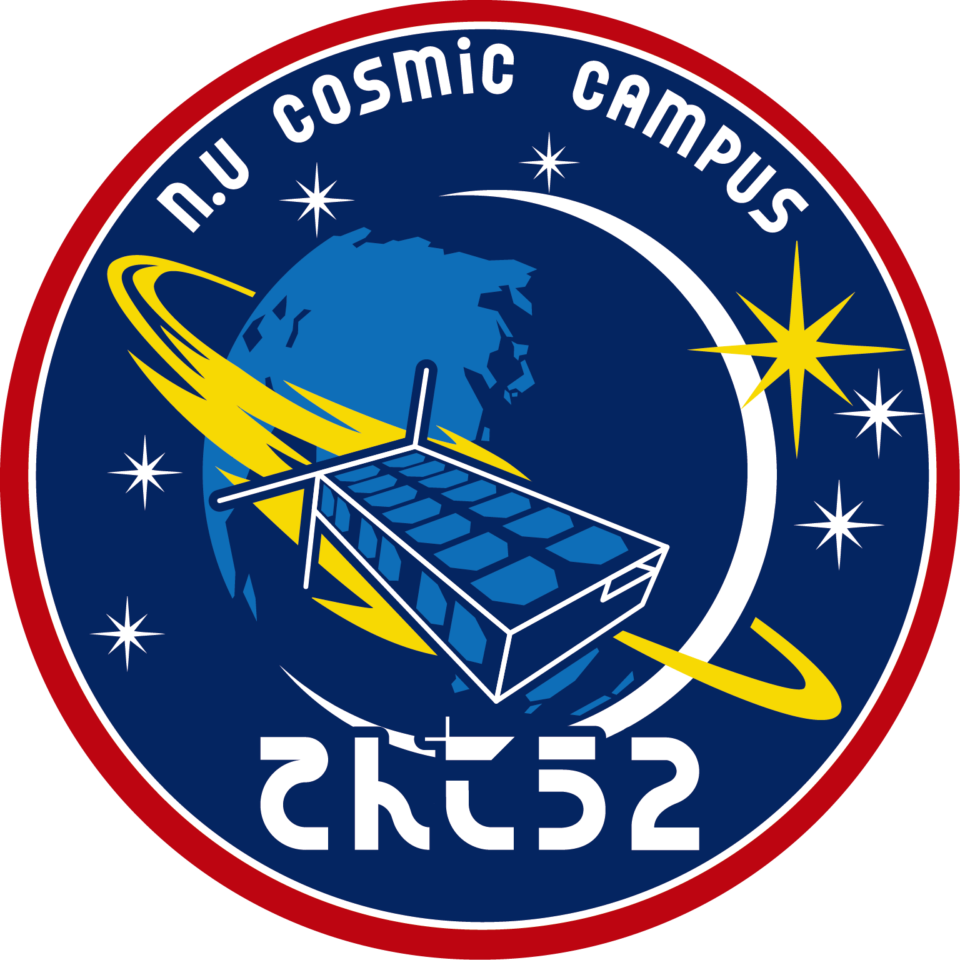
The Low Earth Orbit space environment observation satellite Ten-Koh 2
Second version of Ten-Koh with upgraded experiments.
Launch: FY2022.
Mass: 10 kg
Orbit: TBD (~51 degree inclination at 500 km)
Vehicle: H-3 rocket and first HTV-X vehicle
Shape and size: 6U CubeSat
Technology demonstration satellite in LEO
26
26
26
26

Slide 27
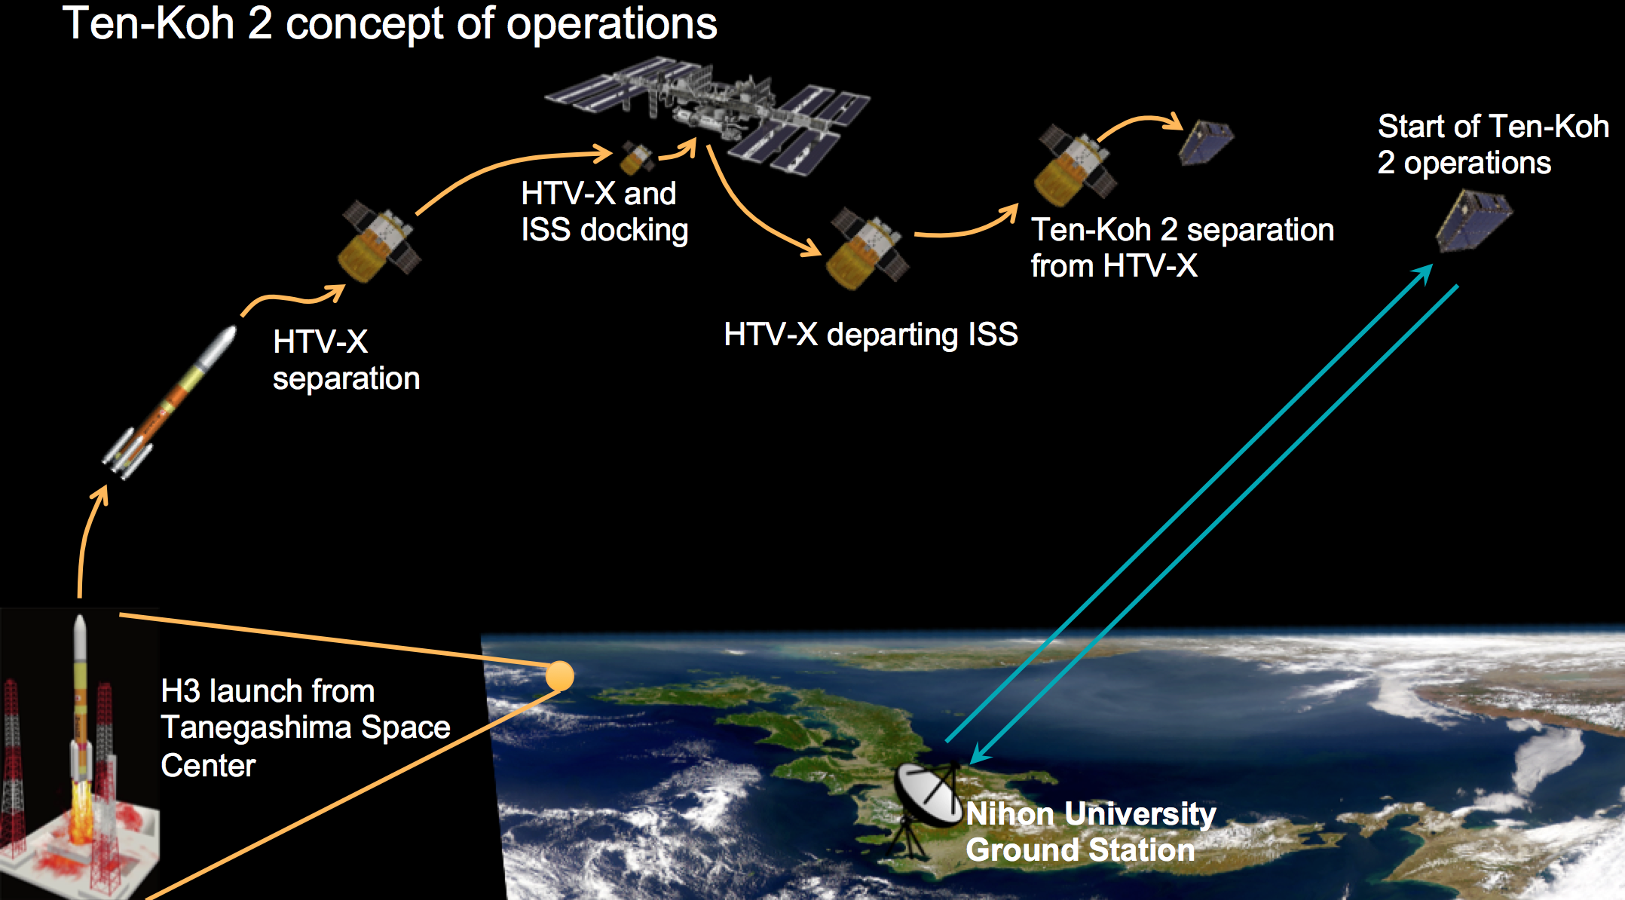
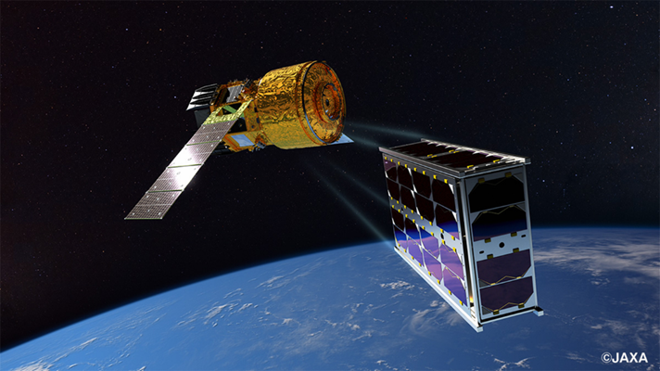
The Low Earth Orbit space environment observation satellite Ten-Koh 2
27
27
27

Slide 28
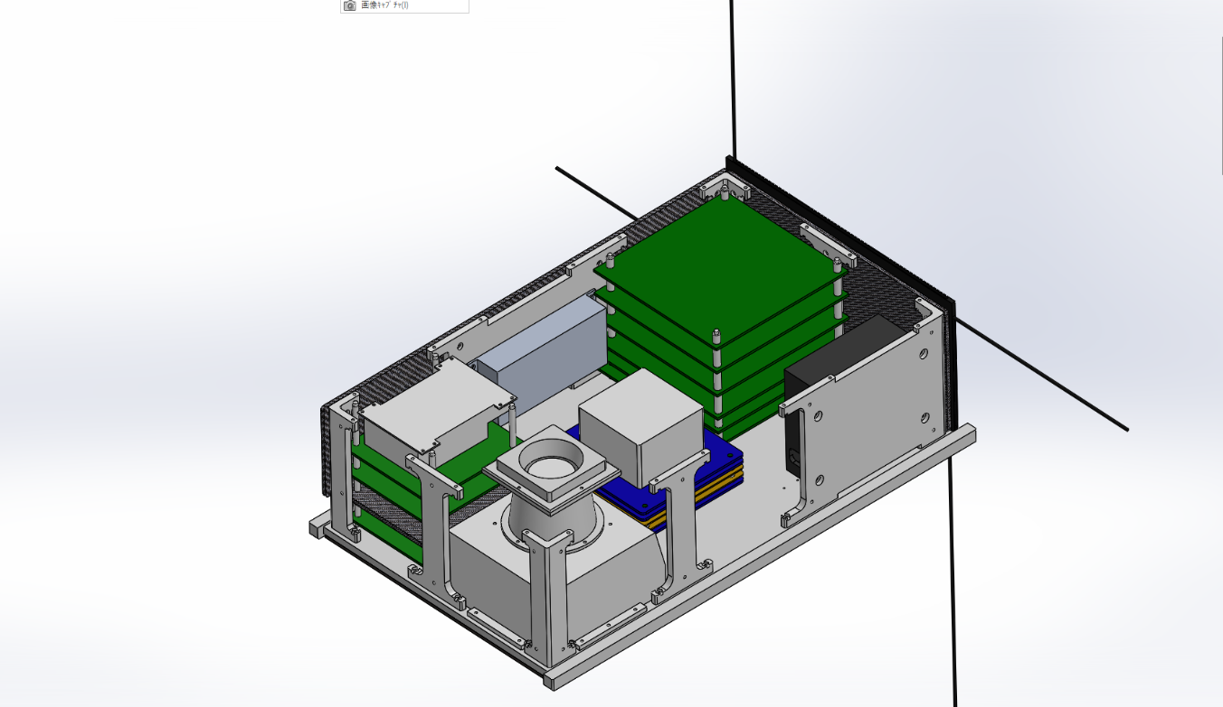
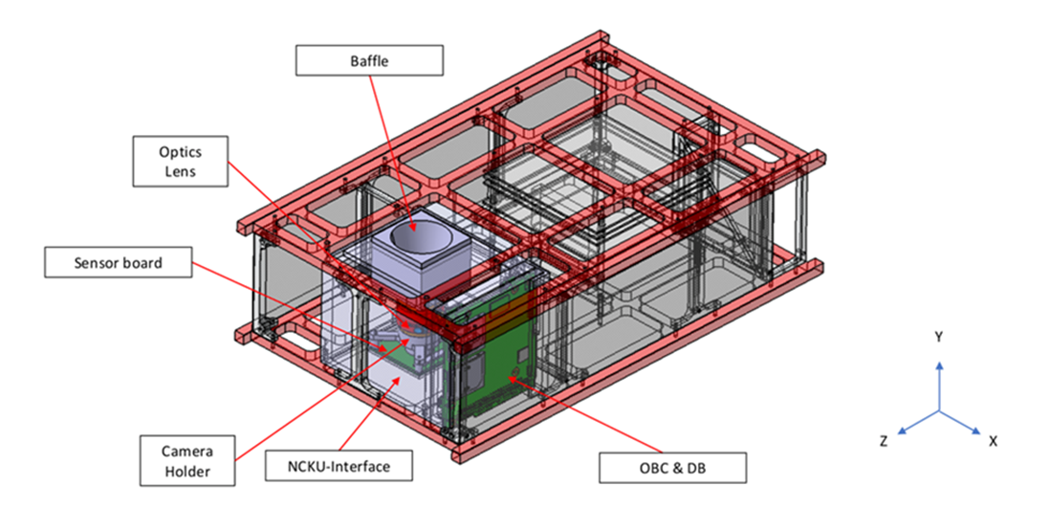
The Low Earth Orbit space environment observation satellite Ten-Koh 2
28
28
28

Slide 29
The Low Earth Orbit space environment observation satellite Ten-Koh 2
Observation of the global environment using a high-resolution camera
Geospace observation using a high-energy charged particle detector
Observation of space environment resistance of advanced space materials
Continuous operation of linear transponders
High-speed data transmission test (4FSK 19.2k BPS)
C band (5.8GHz band) communication technology demonstration
29
29
29
29

Slide 30
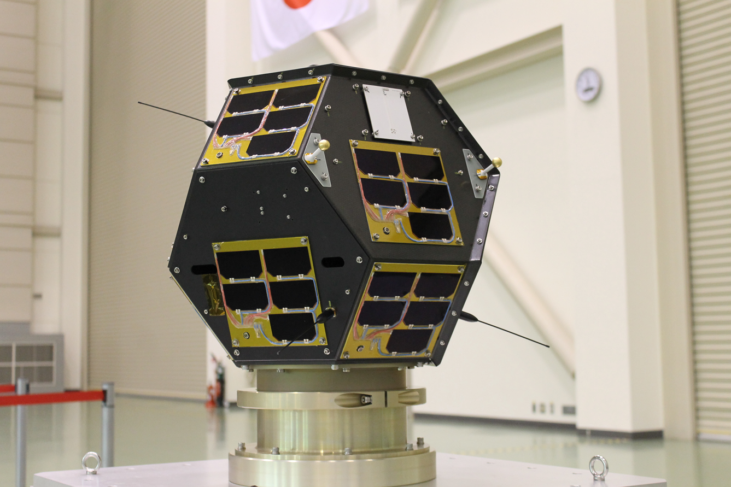
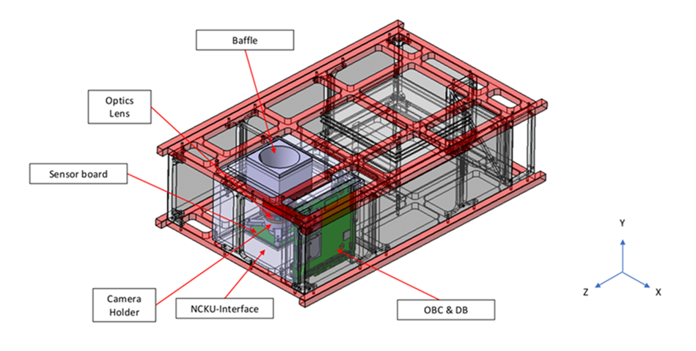
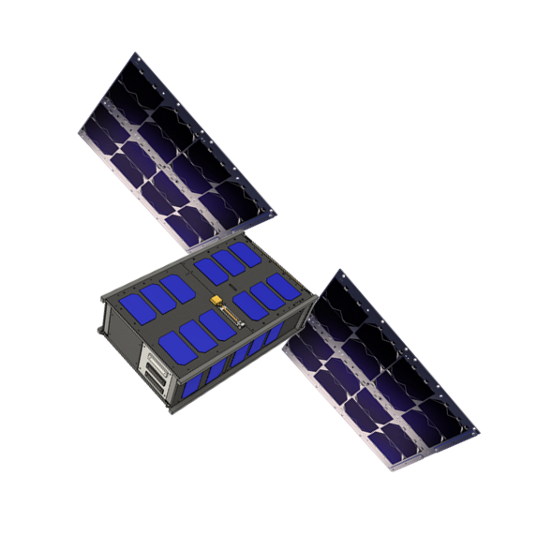
And to our lunar orbiter mission
30
30
30
30

